Slide 1
Annual Interagency Accessibility Forum
CUI
Unlocking the Power of Accessibility
October 11-13, 2022
Workplace Mental Health - Why it's more important than ever to focus on the mental health of your employees
Macey Cox & Emily Follit, National Science Foundation
CUI Contact: cui@nsf.gov

Slide 2
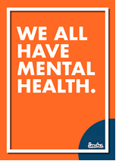
Mental Health Advocates
NSF’s newest Employee Resource Group (ERG)
mentalhealtherg@nsf.gov
Macey Cox, mcox@nsf.gov
Emily Follit, efollit@nsf.gov
Notes:
Menti.com – What Does Mental health Mean to You?
Mental health awareness is on the rise, particularly as COVID-19 continues to drive an epidemic of stress and burnout. That’s why it’s more important than ever for companies to prioritize employee well-being and mental health. This presents unique challenges in the workplace, going beyond just providing mental health options to creating a workplace in which all employees truly feel supported by employers and connected to one another.
Why a Mental Health ERG and why now?
According to a survey by the CDC, during the pandemic, moderate-to-severe anxiety among adults has increased to 37.3 percent
In 2019, Before the pandemic, it was 6.1 percent.
Moderate-to-severe depression hit 30.2 percent, that’s four times higher than prior to the pandemic
Additionally, The Great Resignation has U.S. workers quitting their jobs in record numbers, with two-thirds of millennials who left their jobs in 2021 citing mental health as the driver behind their departure, according to a Mind Share Partners survey. Workplaces must support the mental health of their employees just like they support physical health. 6 in 10 Americans are concerned about this own mental health – rundown, burnout, less vibrant
So if you’ve been feeling a bit “off” since the pandemic started, you’re not the only one. There’s no better time than now to address mental well being.
Source: Mental Health Crisis during the COVID-19 Pandemic (tcf.org)

Slide 3

What is an Employee Resource Group (ERG)?
An Employee Resource Group (ERG) is a voluntary, employee-led group that is aligned with an organization’s mission and helps foster a safe and supportive working environment for all employees. These groups of employees join together in their workplace based on shared interests, characteristics, or life experiences.
Notes:
The purpose of the ERGs are to connect employees with common interests and goals and to advance understanding and inclusion among employees. Groups will meet to discuss and unite under their common interests and goals. The ERGs will also discuss how they can expand diversity and inclusion within the Foundation and how they can contribute to the mission of NSF.
To expand diversity and inclusion an ERG may:
Host guest speakers
Publish information articles on the Weekly Wire
Assist in Special Emphasis Programs
Partner with other ERG's

Slide 4

“Now, every time I witness a strong person, I want to know: what darkness did you conquer in your story? Mountains do not rise without earthquakes.”
- Katherine Mackenette
Notes:
Story

Slide 5
Goals of MHA
Build
Build a culture where employee mental health and well-being are a top priority
Help
Help supervisors understand the benefits of prioritizing mental health
Establish
Establish programs/activities to increase knowledge and access to mental health resources
Empower and support
Empower and support NSF staff to be a resource for others by actively sharing individual experiences with mental health
Provide
Provide a space where teams feel more connected and thus, inspired to be open and vulnerable
Notes:
Having understanding, supportive co-workers and supervisors, makes a HUGE difference. Creating a work culture that embraces mental health, talks about it, and supports employees, is a culture that benefits everyone.
Removing the stigma – providing opportunities for education around mental health and teaching that we all have mental health – common misconception among people is when they hear mental health they equate it with mental illness. We all have mental health and we all have to support our mental health. Talking about mental health isn’t just a discussion about the clinical mental health diagnosis, but it can be a conversation around burnout in the workplace. Supporting mental health in the workplace is a non-negotiable.

Slide 6
Gifts of Imperfection Brené Brown
“Owning our story and loving ourselves through that process is the bravest thing we will ever do”
Notes:
Give short personal story here. Brené Brown is an American research professor, lecturer, author, and podcast host. Brown is known in particular for her research on shame, vulnerability, and leadership.

Slide 7
What are the benefits of supporting mental health?
Increased productivity:
Research shows that nearly 86 percent of employees treated for depression report improved work performance. And in some studies, treatment of depression has been shown to reduce absenteeism and presenteeism by 40 to 60 percent.
Increased retention:
In a 2019 survey of more than 1,500 employees nationwide, more than a third of the respondents said they had left a job due at least in part to mental health. Of these, 59 percent said mental health was the primary reason.
Decreased health care and disability costs:
According to the National Alliance on Mental Illness, rates of cardiovascular and metabolic diseases are twice as high in adults with serious mental illness.
Notes:
How does supporting mental health benefit everyone? Well, we do work at NSF so I don’t expect you to take our word for it, so here are some statistics. Each year, one in five adults in the U.S. will experience mental illness. Yet only one in three who need help, will get it. As a result, many people will either miss work OR will get less done on the job. The latter is known as presenteeism, when people go to work while struggling with physical or mental health issues. This is why focusing on workplace mental health is so important.
The World Health Organization (WHO) estimates that depression and anxiety cost the global economy $1 trillion per year in lost productivity. But WHO also found that for every $1 spent on treating common mental health concerns, there is a return of $4 in improved health and productivity.
Source: Workplace Mental Health: How to Support Employee Mental Wellness | Understood - For learning and thinking differences

Slide 8

Building Our Community
Developed an MS Teams Channel for Mental Health Advocates
Host Monthly Meetings
Quarterly Well-Being Roundtables open to all staff
Hosted webinars and a guest speaker to celebrate October’s World Mental Health Day; hosted events and wrote communications for Mental Health Awareness Month in May
Partner with NSF’s Employee Assistance Program, invite counselor to attend MHA meetings, co-host events with Work/Life Program and other ERG’s, advertise EAP resources to population
Went on a “Road Show” of NSF presenting to everyone we could get in front of about our group, why they should support this group and mental health in the workplace
Notes:
We haven’t really seen challenges with participation because we have been very direct and proactive in our approach to get members on board – we’ve been open with our stories and our own struggles and been willing to create safe spaces for people to feel comfortable to share (lead by example)…getting the word out in multiple formats – monthly meeting, internal agency newsletter articles, branding with our flyers, consistent events or presence in Foundation. Engagement on the DEIA Strategic Planning Team to weigh in from the MHA perspective
We stood this group up in March 2021 and everything we’ve done has been virtual because it’s had to be – somewhat easier in that environment to share our stories but harder to connect on a deeper level. We are excited for the future workplace to build some level of face to face community, in person events, and more. It may open up communication and connection on this topic even more.
We now have 90 members on our channel
Consistently meeting with members continues our constant conversation
Events
Have presented to approximately 1,180 staff members.
Seeking storytellers and an Executive Champion

Slide 9
What can you do as a leader to support your employee's mental health?
Tell your story – don’t be afraid to share your struggles
Ask good questions and check in with your staff
Listen
Know your agencies available resources – EAP, Talk Now, Work/Life Programs, Employee Resource Groups
Leverage learning resources through your agency
Notes:
As Leaders, you have to model the importance of mental well being – speak up, tell your story – be open and vulnerable – it gives permission for others to share; prioritize your mental health and take mental health days; talk to your employees about how they are doing
Be a good listener – Ask yourself WAIT – Why Am I Talking
Resources: NSF has access to Linkedin learning which has thousands of on demand learning opportunities including courses focused on mental well being, work/life balance and burnout that all employees can benefit from

Slide 10
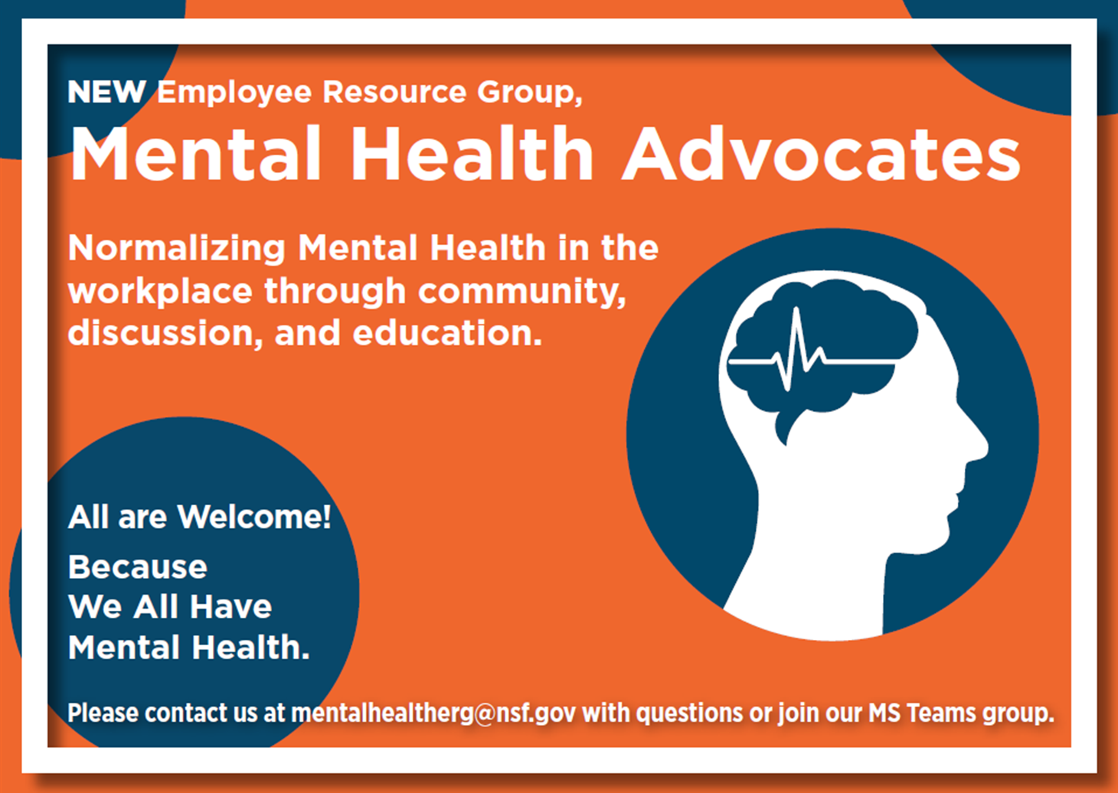
Mental Health Advocates Contact Info:
Macey Cox, mcox@nsf.gov
Emily Follit, efollit@nsf.gov
mentalhealtherg@nsf.gov
Notes:
So if you yourself, or someone you know, struggles with Mental Health challenges, please connect with us We are happy to speak with your teams, to normalize this message of mental health in the workplace.

